Slide 1
Predicting Tesla Stock Prices Using LSTM Neural Networks

Slide 2
Content
Executive Summary
Introduction
Methodology
Code Implementation
Predicting Tesla Stock Prices With LSTM
Results
Conclusion

Slide 3
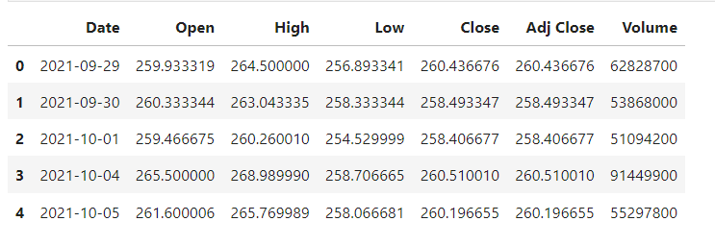
Executive Summary
The report outlines the creation and application of a Long Short-Term Memory (LSTM) model designed to predict Tesla's stock prices based on historical data. By leveraging this model, traders and financial analysts can gain valuable insights into future price trends. The method involves several key steps including data preprocessing to ensure accuracy and consistency, model development to establish predictive capabilities, and training to optimize performance. The model's effectiveness is assessed to gauge its accuracy and reliability in predicting Tesla's stock prices. The findings and recommendations are discussed, highlighting the potential benefits and limitations of using LSTM models for stock price prediction.

Slide 4
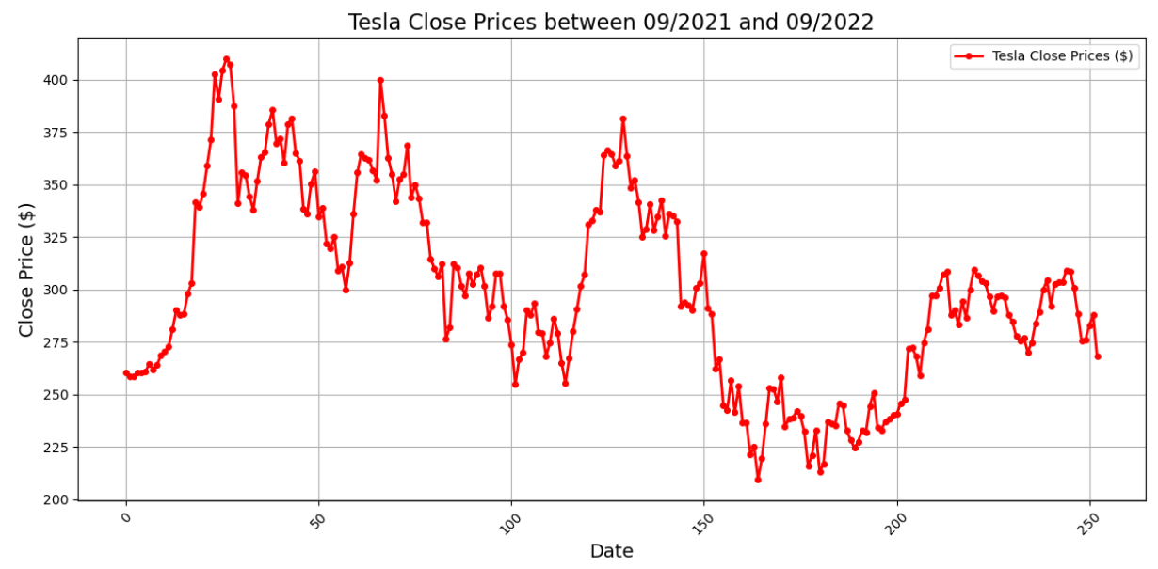
Introduction
Tesla, Inc. is a pioneer in the electric vehicle sector and is known for the significant volatility of its stock prices. The ability to accurately predict these fluctuations is crucial for investors and traders. Traditional time-series forecasting methods struggle to capture the complex patterns in stock price movements. This report explores the application of LSTM networks, which are capable of retaining information over extended periods, to provide a robust framework for predicting future patterns. The inherent memory capabilities of LSTM models decode the dynamic factors influencing Tesla's stock prices, aiming to furnish investors and analysts with a powerful tool.

Slide 5
Methodology Enhancing Predictive Accuracy
Data Acquisition
Data for the study includes daily stock prices of Tesla from January 2019 to December 2021, sourced from the Yahoo Finance website. This dataset offers a comprehensive look at opening, closing, high, and low prices, along with trading volume for each trading day.
Data Preprocessing
The dataset underwent several preprocessing steps such as normalization using MinMaxScaler to aid model convergence and splitting into training and testing sets in an 80/20 ratio. Sequence creation for model training was also executed to facilitate the learning of temporal dependencies.
Model Architecture
The LSTM model architecture incorporates multiple layers to effectively capture the temporal dynamics in the stock prices. This includes dual LSTM layers with dropout for overfitting mitigation, and an output layer structured for price prediction. The compilation utilizes Adam optimizer and mean square error metric.

Slide 6
Code Implementation From Data Handling to Insights
Visualizing Data
Visualization techniques such as line plots and histograms are utilized to understand the distribution as well as temporal trends in Tesla's closing prices.
Reading the Dataset
The dataset is loaded into a DataFrame using pandas library which allows for manipulation and analysis of homogeneously typed data collections.
Data Exploration
Basic exploration involves calculation of statistical measures like mean and standard deviation. Further exploration includes identifying useless columns, performing visual EDA, feature selection based on data distribution, and handling outliers and missing values.
Correlation Analysis
Correlation matrices constructed and visualized help identify relationships between various stock metrics. Statistical correlation analysis further supports the model's development by highlighting significant features.

Slide 7
Predicting Tesla Stock Prices With LSTM Detailed Analysis and Outcomes
Training the LSTM Model
Sequences of historical price data serve as input for LSTM, which learns to predict future prices. The model undergoes extensive training with the aid of early stopping mechanisms to avoid overfitting.
Model Performance and Validation
Post training, predictions are made on both train and test datasets to validate the model's accuracy. Key performance indicators like Root Mean Squared Error (RMSE) are computed to assess efficacy.
Visualization of Results
Graphical representations compare predicted versus actual prices, illustrating the model's predictive prowess.

Slide 8
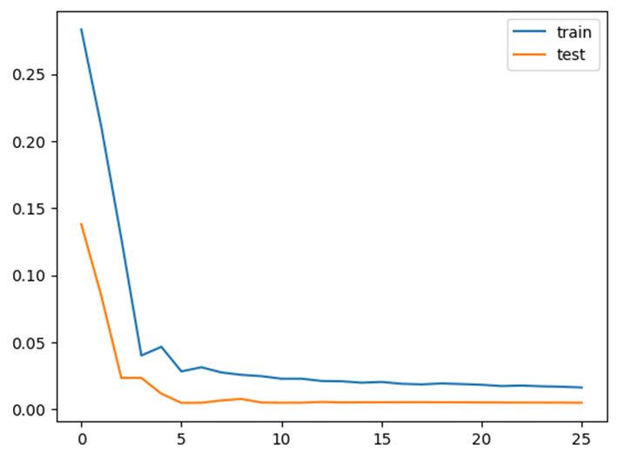
Results
The LSTM model achieved a root mean squared error (RMSE) of 14.0172 on the training dataset and 9.2723 on the test dataset, demonstrating high accuracy in predicting Tesla’s stock prices. Visualization of predicted vs. actual prices was used to illustrate the model’s performance.

Slide 9
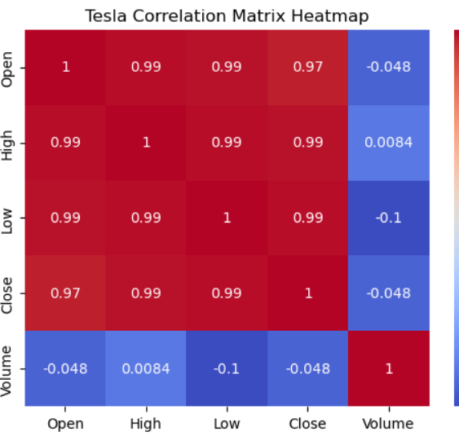
Conclusion
The LSTM model showed strong potential in predicting stock prices with high accuracy. It outperformed standard models, indicating that deep learning, particularly LSTM networks, can significantly enhance stock market analytics. Future work may explore more granular data, incorporate additional features such as macroeconomic indicators, and test the model across different stock datasets

Slide 10
Reference
Hochreiter, S., & Schmidhuber, J. (1997). Long short-term memory. Neural computation, 9(8), 1735-1780.
Brownlee, J. (2018). Introduction to Time Series Forecasting with Python: How to Prepare Data and Develop Models to Predict the Future. Machine Learning Mastery.
Jason Brownlee. (2019). Deep Learning for Time Series Forecasting. Machine Learning Mastery.
Karpathy, A., et al. (2015). The Unreasonable Effectiveness of Recurrent Neural Networks. Andrej Karpathy Blog.
Cao, Q., et al. (2018). A Comprehensive Review of Time Series Forecasting Techniques: Implementations in Python. Technical Report, University of California, Riverside.

